Slide 1
MIS 412:Knowledge Management Lecture 1&2: Introduction to KM
Okuboyejo SR

Slide 2
Content
Definition and concept of knowledge management
Activities involved in knowledge management.
Different approaches to knowledge management.
Knowledge management and technology
Benefits as well as drawbacks to knowledge management initiatives

Slide 3
The Importance of Knowledge
Cases

Slide 4
Case One
In one company, the financial manager decided to reduce the budget by laying off some employees . One of them was the best maintenance engineer.
After some months, one machine stopped working due to damage of some parts
the company tried many times to fix it, but it could not. So it is forced to engage the engineer himself to repair that machine .
Actually the engineer installed that part using his hammer for the convenience of the new part and put it in the right position so he returned the machine to work in minutes.
After that he made a repair bill of $ 1000. However , the cost of the hammer by the engineer installed did not exceed one dollar?
Can you justify ($ 999)!...

Slide 5
Case Two
One financial firm faced a complex problem due to the mistakes of mathematical accumulated since the exit of financial manager of retirement.
After that; many problems had been happened related to taxes and funded with many companies and banks.
For solving these problems, several committees had been formed without any results, So the company decided to outsource the financial manager himself who had been able to solve the problem within three days
After that, he had submitted an invoice for resolving these problems account in the amount of $ 5,000, and when he asked about the actual amount used to accomplish the work during Three days it was $ 500 only
Do you have any justification for ($ 4,500)!

Slide 6
Knowledge management (Definition)
From the perspective of any enterprise knowledge management (KM) is the systematic and effective utilization of essential information
Includes knowledge
identifying,
restructuring, and
exploitation.
KM is connected to organizational memory

Slide 7
Example: Siemens & ShareNet
ShareNet is a web-service, which
stores knowledge
enables information search
enables communication
Microsoft Office Online
You can comment on help instructions
Wikipedia
You can write own definitions and clarifications
See
http://en.wikipedia.org/wiki:FAQ
for more details.

Slide 8
Knowledge terminology
Data are a collection of:
Facts
Measurements
Statistics
Information is organized or processed data that are:
Timely
Accurate
Knowledge is information that is:
Contextual
Relevant
Actionable.
Having knowledge implies that it can be exercised to solve a problem, whereas having information does not.

Slide 9
Knowledge Management Principles
KM is expensive (but so is stupidity!)
Effective management of knowledge requires hybrid solutions of people and technology.
KM is highly political.
KM requires knowledge managers.
KM benefits more from map than models, more from markets than from hierarchies.
Sharing and using knowledge are often unnatural acts.
KM means improving knowledge work processes.
Knowledge access is only the beginning.
KM never never ends.
KM requires a knowledge contract.
Source: Thomas Davenport, "Some Principles of Knowledge Management," http://www.utexas.edu/kman/kmprin.htm

Slide 10
Knowledge Management Principles
The more your share, the more you gain.
The knowledge acquisition process should be part of the work process.
Integration of knowledge from multiple disciplines has the highest probability of creating new knowledge and value-added.
Knowledge valuation should be conducted from customers’ perspective.
KM focus should be on core knowledge critical to sustaining company’s competitive edge.

Slide 11
Organizational Knowledge Management Model
Leadership
KM Process
Culture
Share
Apply
Organization
Group
Individual
Create
Organize
Identify
Adapt
Collect
Business
Process
Performance
Measurement
Technology
Source: Adapted from Arthur Andersen and the American Productivity and Quality Center

Slide 12
Knowledge Management Context
IT infrastructure is a critical component of knowledge management (KM); however, KM encompasses much more than IT does.
Business Environment
Business strategy/goals
Customer/supplier alliance
Competitive factors
Collaborative processes
Information sharing
Process teams
Reward system
Business Process &
Work Environment
Best practices
External/internal knowledge
Process models/templates
Context & Content
Intranets/groupware/e-mail
Object databases
Document management
Videoconferencing/EMS
IT Infrastructure

Slide 13
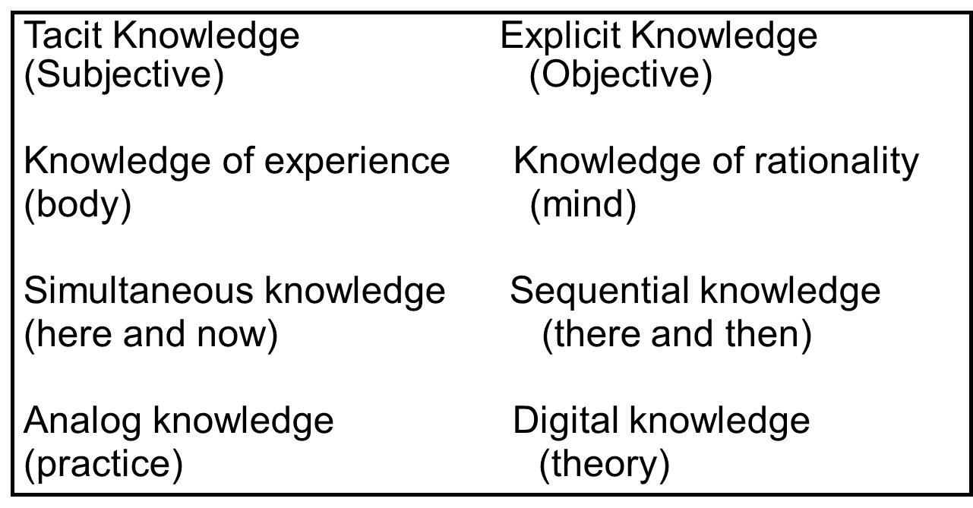
Theory of Organizational Knowledge Creation
Tacit knowledge is personal, context-specific, and therefore hard to formalize and communicate.
Explicit or codified knowledge is transmittable in formal, systematic language.
Source: Knowledge-Creating Company, p. 57.

Slide 14
Theory of Organizational Knowledge Creation
Tacit knowledge is personal, context-specific, and therefore hard to formalize and communicate.
Explicit or codified knowledge is transmittable in formal, systematic language.
Tacit Knowledge Explicit Knowledge (Subjective) (Objective)
Knowledge of experience Knowledge of rationality
(body) (mind)
Simultaneous knowledge Sequential knowledge
(here and now) (there and then)
Analog knowledge Digital knowledge
(practice) (theory)
Source: Knowledge-Creating Company, p. 57.

Slide 15
Explicit knowledge
Explicit knowledge (or leaky knowledge) deals with objective, rational, and technical knowledge
Data
Policies
Procedures
Software
Documents
Products
Strategies
Goals
Mission
Core competencies

Slide 16
Tacit knowledge
Tacit knowledge is the cumulative store
of the corporate experiences
Mental maps
Insights
Acumen
Expertise
Know-how
Trade secrets
Skill sets
Learning of an organization
The organizational culture

Slide 17
Dynamic cycle of knowledge
Firms recognize the need to integrate both explicit and tacit knowledge into a formal information systems - Knowledge Management System (KMS)
Phases of knowledge
Create knowledge.
Capture knowledge.
Refine knowledge.
Store knowledge.
Manage knowledge.
Disseminate knowledge.

Slide 18
Aims of KM initiatives
to make knowledge visible mainly through
Maps
yellow pages
hypertext
to develop a knowledge-intensive culture,
to build a knowledge infrastructure

Slide 19
KM Initiatives
Knowledge creation or knowledge acquisition is the generation of new insights, ideas, or routines.
Socialization mode refers to the conversion of tacit knowledge to new tacit knowledge through social interactions and shared experience.
Combination mode refers to the creation of new explicit knowledge by merging, categorizing, reclassifying, and synthesizing existing explicit knowledge
Externalization refers to converting tacit knowledge to new explicit knowledge
Internalization refers to the creation of new tacit knowledge from explicit knowledge.
Knowledge sharing is the exchange of ideas, insights, solutions, experiences to another individuals via knowledge transfer computer systems or other non-IS methods.
Knowledge seeking is the search for and use of internal organizational knowledge.

Slide 20
KM approaches
There are two fundamental approaches to knowledge management: :
process approach
practice approach
In addition, Turban et al. mention best practices and hybrid approaches

Slide 21
Process Approach
is favored by firms that sell relatively standardized products since the knowledge in these firms is fairly explicit because of the nature of the products & services.

Slide 22
Practice approach
is typically adopted by companies that provide highly customized solutions to unique problems. The valuable knowledge for these firms is tacit in nature, which is difficult to express, capture, and manage.

Slide 23
KM and technology
Ideology more important than technology
Technologies
Communication technologies allow users to access needed knowledge and to communicate with each other.
Collaboration technologies provide the means to perform group work.
Storage and retrieval technologies (database management systems) to store and manage knowledge.

Slide 24
Supporting technologies of KM
Artificial Intelligence
Intelligent agents
Knowledge Discovery in Databases (KDD)
Data mining
Model warehouses & model marts
Extensible Markup Language (XML)

Slide 25
Artificial Intelligence
Scanning e-mail, databases and documents helping establishing knowledge profiles
Forecasting future results using existing knowledge
Determining meaningful relationships in knowledge
Providing natural language or voice command-driven user interface for a KM system

Slide 26
Intelligent agents
Learn how a user works and provides assistance for her/his daily tasks
Two types
Passive agents
Active agents

Slide 27
Knowledge Discovery in Databases (KDD)
Is a process used to search for and extract useful information from volumes of documents and data. It includes tasks such as:
knowledge extraction
data archaeology
data exploration
data pattern processing
data dredging
information harvesting

Slide 28
Data mining
the process of searching for previously unknown information or relationships in large databases, is ideal for extracting knowledge from databases, documents, e-mail, etc.
For example technical analysis of stocks and stock markets can be done by using data mining

Slide 29
Model warehouses & model marts (1/2)
extend the role of data mining and knowledge discovery by acting as repositories of knowledge created from prior knowledge-discovery operations
For example with ExpertRuleKnowledgeBuilder http://www.xpertrule.com/pages/info_kb.htm you can build rules for this kind of operations

Slide 30
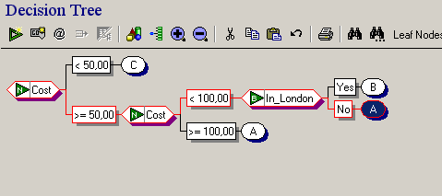
Model warehouses & model marts (2/2)
Decision model about travel expenses
A=First Class hotel B=Second Class hotel C=Third class hotel
This knowledge can be in use when the hotel rooms are booked for different kind of staff as well as when travel expense reports are processed. (source: XpertRuleKnowledgeBuilder).

Slide 31
Extensible Markup Language (XML)
enables standardized representations of data structures, so that data can be processed appropriately by heterogeneous systems without case-by-case programming.

Slide 32
KM system implementation
Software packages
For example Microsoft SharePointPortal
Consulting firms
Outsourcing (ASP)

Slide 33
Classification of KM software (knowware) (1/2)
Collaborative computing tools
Knowledge servers
For example IDOL server
Enterprise knowledge portals
Important because individuals spend 30% of their time looking for information
Single point access

Slide 34
Classification of KM software (knowware) (2/2)
Electronic document management
Content management systems
Document content should be consistent and accurate across an enterprise
Knowledge harvesting tools
For example, Knowledge mail
Search engines
Knowledge management suites

Slide 35
KM success factors
There should be a link to a firm’s economic value-business processes should be connected to KM
For example
Development of new products process
Customer service process
Technological infrastructure and knowledge infrastructure
Organizational culture should be ready for KM
Introducing a system to employees
(In the first phase prototypes and demos are useful, if the ideology of KM is new for a firm)

Slide 36
KM failures
Failure rate range from 50% to 70%
Major objectives are not reached
Some reasons
Information may not be easily searchable
Inadequate or incomplete information in a system
Lack of commitment

Slide 37
Example again: Siemens & ShareNet
Employees were supported and encouraged to adopt KM
Communication
Training
Rewards
Top management’s full support
Maintenance team which was responsible for the validity of knowledge

Slide 38
References
Turban et al., IT for management, 2004 & 2006
Riitta Partala’s lecture at the university of Jyväskylä
Pekka Makkonen

